Slide 1
Understanding the response of the system
Quantifying current forcing to the system
Grass
1
3
Hupsel Catchment
Reference ET
Data: Hupsel 2014
ET_{act}/ET_{ref}
Reference ET
Data: Hupsel 2021
Actual ET (from EC)
Bare soil
2
4
Hupsel Catchment
Reference ET
Actual ET for 2021
Data: TransRegio
ET_{act}/ET_{ref}
Actual ET (from EC)
Estimation current response of the system

Slide 2
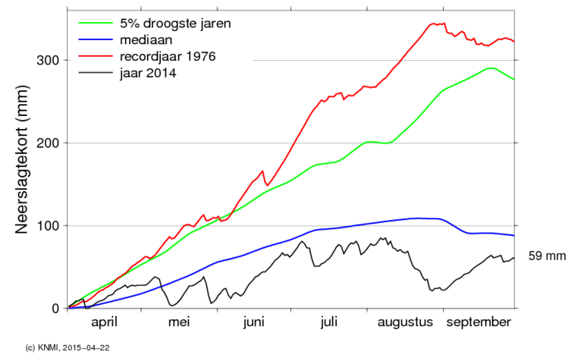
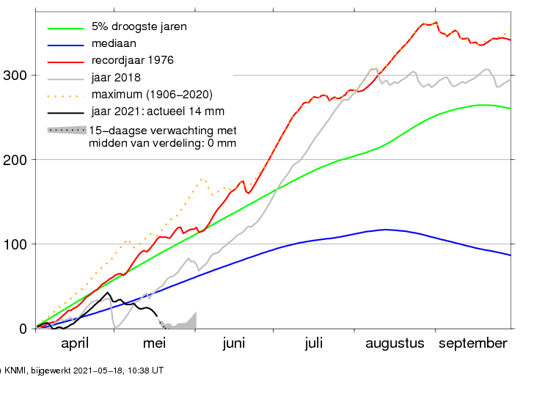
Precipitation deficit 2014 (13 stations)
Precipitation deficit 2021 (13 stations)
cumulative precipitation deficit (mm)

